Slide 1
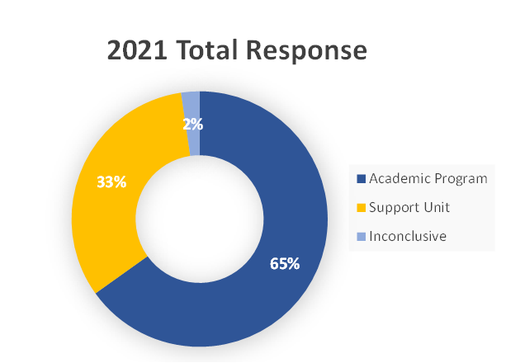
A Comparative Analysis of Year One and Year Two Usage of a Data Management Program as an Assessment Tool
GLADYS KATUBIYA
Department of Institutional Effectiveness and Research | Dr. Dan Su, Alison Soeder, Tracy Stewart
BACKGROUND
Texas A&M University – Commerce (TAMUC) is located in Commerce, Texas and joined the Texas A&M University System in 1996.
The university aims to transform its students’ lives through departmental objectives that focus on advancing knowledge and fostering collaboration.
TAMUC documents expected student learning outcomes (SLOs) and goals and evaluates whether these outcomes have been met.
SLOs are updated and managed in a digital assessment management platform called the Nuventive™ Improvement Platform.
Research questions are addressed using a survey. Survey questions addressed:
  The efficiency of the Nuventive Improvement Platform
  Productivity of the review and approval process
  User accessibility
RESULTS
At least 81% of the respondents in year 2 agreed with the facilitation of the year’s IE cycle in each category, while year 1 showed 88% agreed with the facilitation.
In year 2, more respondents did not agree that communications provided sufficient information to complete IE reports.
90% of the respondents agreed with the accuracy of assessment measures in year 2.
94% of the respondents agreed with the accuracy of assessment measures in year 1.
84% of the respondents were satisfied with features of the platform in year 2 and 92% were satisfied with the features in year 1.
In year 2 most participants selected Curriculum/Program mapping as a topic of interest for additional resources or training opportunities. Most participants in year 1 selected Developing SLOs/Goals and Implementing assessment methods.
RESEARCH QUESTION/ OBJECTIVE
This study intends to analyze the differences in user feedback from the first year of campus implementation to the second year use of the assessment software. The data gathered from software evaluations will demonstrate changes in the number of respondents, the number of satisfied users, the number of dissatisfied users, software strengths and weaknesses.
The purpose of this study:
  Analyze the differences in user feedback from Year 1 to Year 2
  Identify key improvement areas
METHODOLOGY
Survey using a self –administered web based questionnaire.
Participants - Institutional Effectiveness (IE) Authors and individuals involved in the IE review process.
Statistical analysis conducted using Microsoft Excel
The study uses qualitative and quantitative feedback, and descriptive statistics are applied to compare the two years of data
The study assessed Likert scale questions and open-ended questions addressing the experiences in the use of the assessment software and also measured users’ satisfaction with the platform's features and training resources.
2021 response rate – 29% (43 out of 152 authors)
2020 response rate – 45% (68 out of 151 authors)
CONCLUSIONS
                Year 2 experienced a reduction in the response rate possibly due to survey fatigue.
                More than 80% of the respondents were satisfied with the data management program as an assessment tool.
                In both years respondents found the platform productive and well-structured.
                More respondents in year 2 noted dissatisfaction with the assessment software than in year 1.
RECOMMENDATIONS
                Improving communications about IE cycle by frequently sending out emails.
                Providing and uploading more resources in Nuventive.
                Introduction of regular software updates to make it more interactive and user friendly.

